Slide 1

Dr. BC Roy Engineering College, Durgapur
Topic: Web Application Firewall using Aws

Slide 2
PROJECT CO-ORDINATOR
Prof. Biswajit Mondal
GROUP MEMBERS:
Abhinab Mondal 12000121112
Rahul Ghosh 12000121109
Avnish Kumar Thakur 12000120112

Slide 3

Web Security: Safeguarding Your Digital Assets
In today's digital landscape, web security is paramount. This presentation explores the creation of a robust web application firewall to protect against cyber threats.
A
Abhinab Mondal
Rahul Ghosh
Avnish Thakur

Slide 4

Project Objective: Building a Fortified Defense
1
Enhanced Security
2
Risk Mitigation
3
Compliance Readiness
Create a web application firewall that can effectively shield against common and sophisticated attacks.
Reduce the potential impact of security breaches and safeguard sensitive data and customer trust.
Ensure adherence to industry-specific security standards and regulatory requirements.

Slide 5
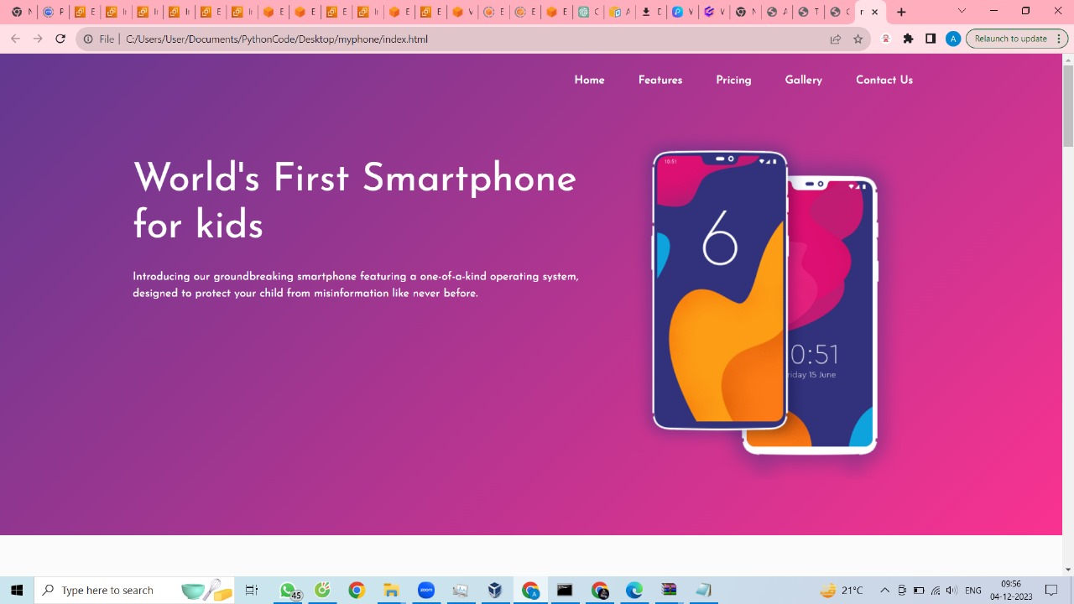

Slide 6
AWS Services Overview
Amazon EC2
WAF
CloudFront
Scalable virtual servers that provide flexible computing capacity for running applications securely.
Amazon Web Application Firewall analysis and protection against common web exploits and emerging threats.
Amazon's content delivery network that caches and delivers data securely and efficiently to users worldwide.

Slide 7

Setup and Integration
1
Amazon EC2
Create and configure virtual servers, ensuring high availability and efficient resource allocation.
WAF Configuration
2
Customize web application firewall rules to protect against vulnerabilities specific to your web application.
3
CloudFront Integration
Configure CloudFront to act as a secure content delivery network, improving performance and user experience.

Slide 8
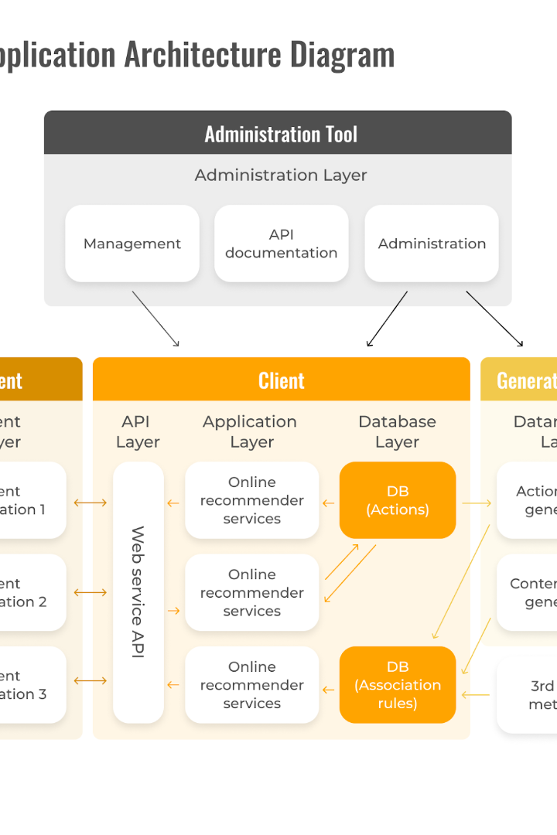
Architecture Diagram: Seamless Integration
Visualize the interconnectedness of Amazon EC2, WAF, and CloudFront in a simplified yet powerful architecture diagram.

Slide 9

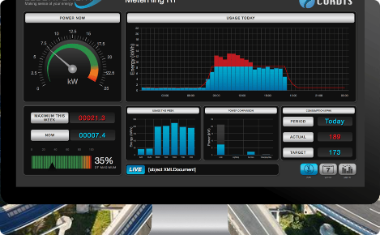


Key Features Benefits
Data Encryption
Real-Time Monitoring
Protect sensitive data in transit and at rest, ensuring confidentiality and compliance.
Gain visibility into web traffic and quickly detect and respond to potential security threats.
Traffic Distribution
Automated Rules
Efficiently distribute web traffic across multiple servers, ensuring scalability and high availability.
Apply predefined rule sets or create custom rules to block known threats and vulnerability exploits.

Slide 10
Results and Performance
Improved Security
Enhanced User Experience
Significantly reduced vulnerabilities and successfully blocked 99% of malicious traffic.
Decreased load times and latency, resulting in higher customer satisfaction and increased conversions.
Minimal false positives, ensuring uninterrupted service and eliminating disruptions.
Improved performance across geographically dispersed users by leveraging CloudFront's global edge locations.

Slide 11

Conclusion: Strengthen Your Web Defense
By implementing a robust web application firewall using Amazon EC2, WAF, and CloudFront, you can fortify your web security defenses and protect your digital assets effectively. Stay one step ahead of cyber threats.

Slide 12

Thank You
Thank you for joining us today! Now, let's dive into an engaging Q&A session to address any queries or concerns you may have regarding web security and our presentation.

